Slide 1
Remove Pin Name User Manual

Slide 2
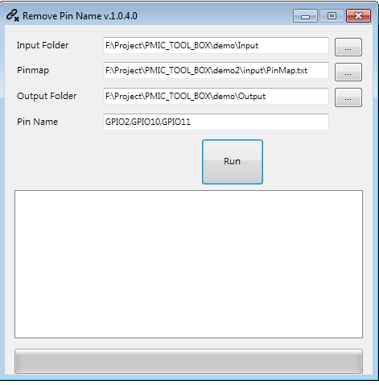
Remove Pin Name
Purpose
To remove the specific pin in the pattern.
GUI

Slide 3
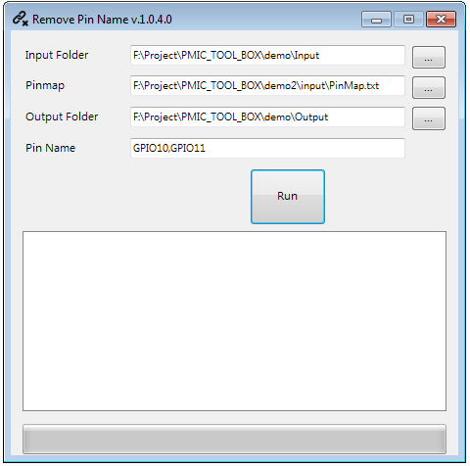
Remove Pin Name
The path of the input patterns folder
PinMap
The path of the output patterns folder
Which pins needed to be removed,
Support “,” to separate pins.
Last step: RUN

Slide 4
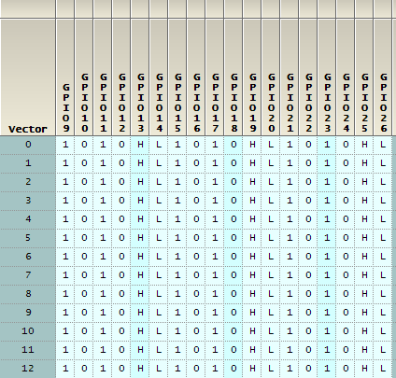
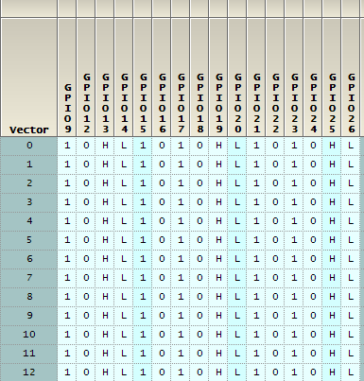
Remove Pin Name -Result
Removed GPIO10,GOIO11 as example

